Slide 1

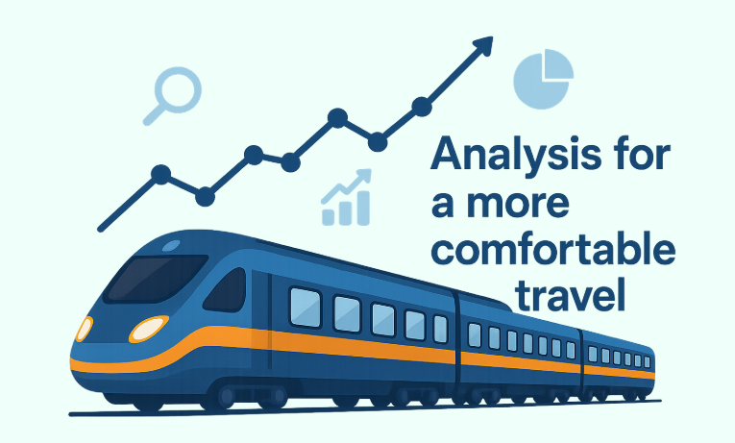
UK Train Rides Analysis Dashboard
YAT 402A Group 1 Project
Abdullah Maher Abdullah
Hanan Mohammed Mohammed
Michael Sherif Youssef
Mohamed Mahmoud Ahmed
Omnia Hussein Ali

Slide 2

Introduction
Project: UK Train Rides Analysis Dashboard
Goal: Provide a data-driven platform to improve train service efficiency, track delays, and optimize schedules.
Key Features:
Cleaned dataset with historical train ticket data.
Interactive Power BI dashboard with real-time insights.

Slide 3
Overview & Goals
Overview: The project uses Power BI to analyze train ticket sales, passenger behavior, service performance, and delays.
Goals:
Clean and preprocess raw data for analysis.
Create an interactive dashboard for stakeholders to track key metrics such as revenue, delays, and customer behavior.
Facilitate decision-making for service improvement and schedule optimization.

Slide 4
Dashboard Structure
Overview
High-level metrics and key performance indicators (KPIs).
Revenue
Insights into ticket revenue trends, refunds, and sales.
Stations & Time
Departure stations, busiest routes, and peak travel times.
Passengers
Passenger behavior, ticket usage, and railcard trends.
Refund & Delay
Impact of delays on passenger satisfaction and refund requests.

Slide 5
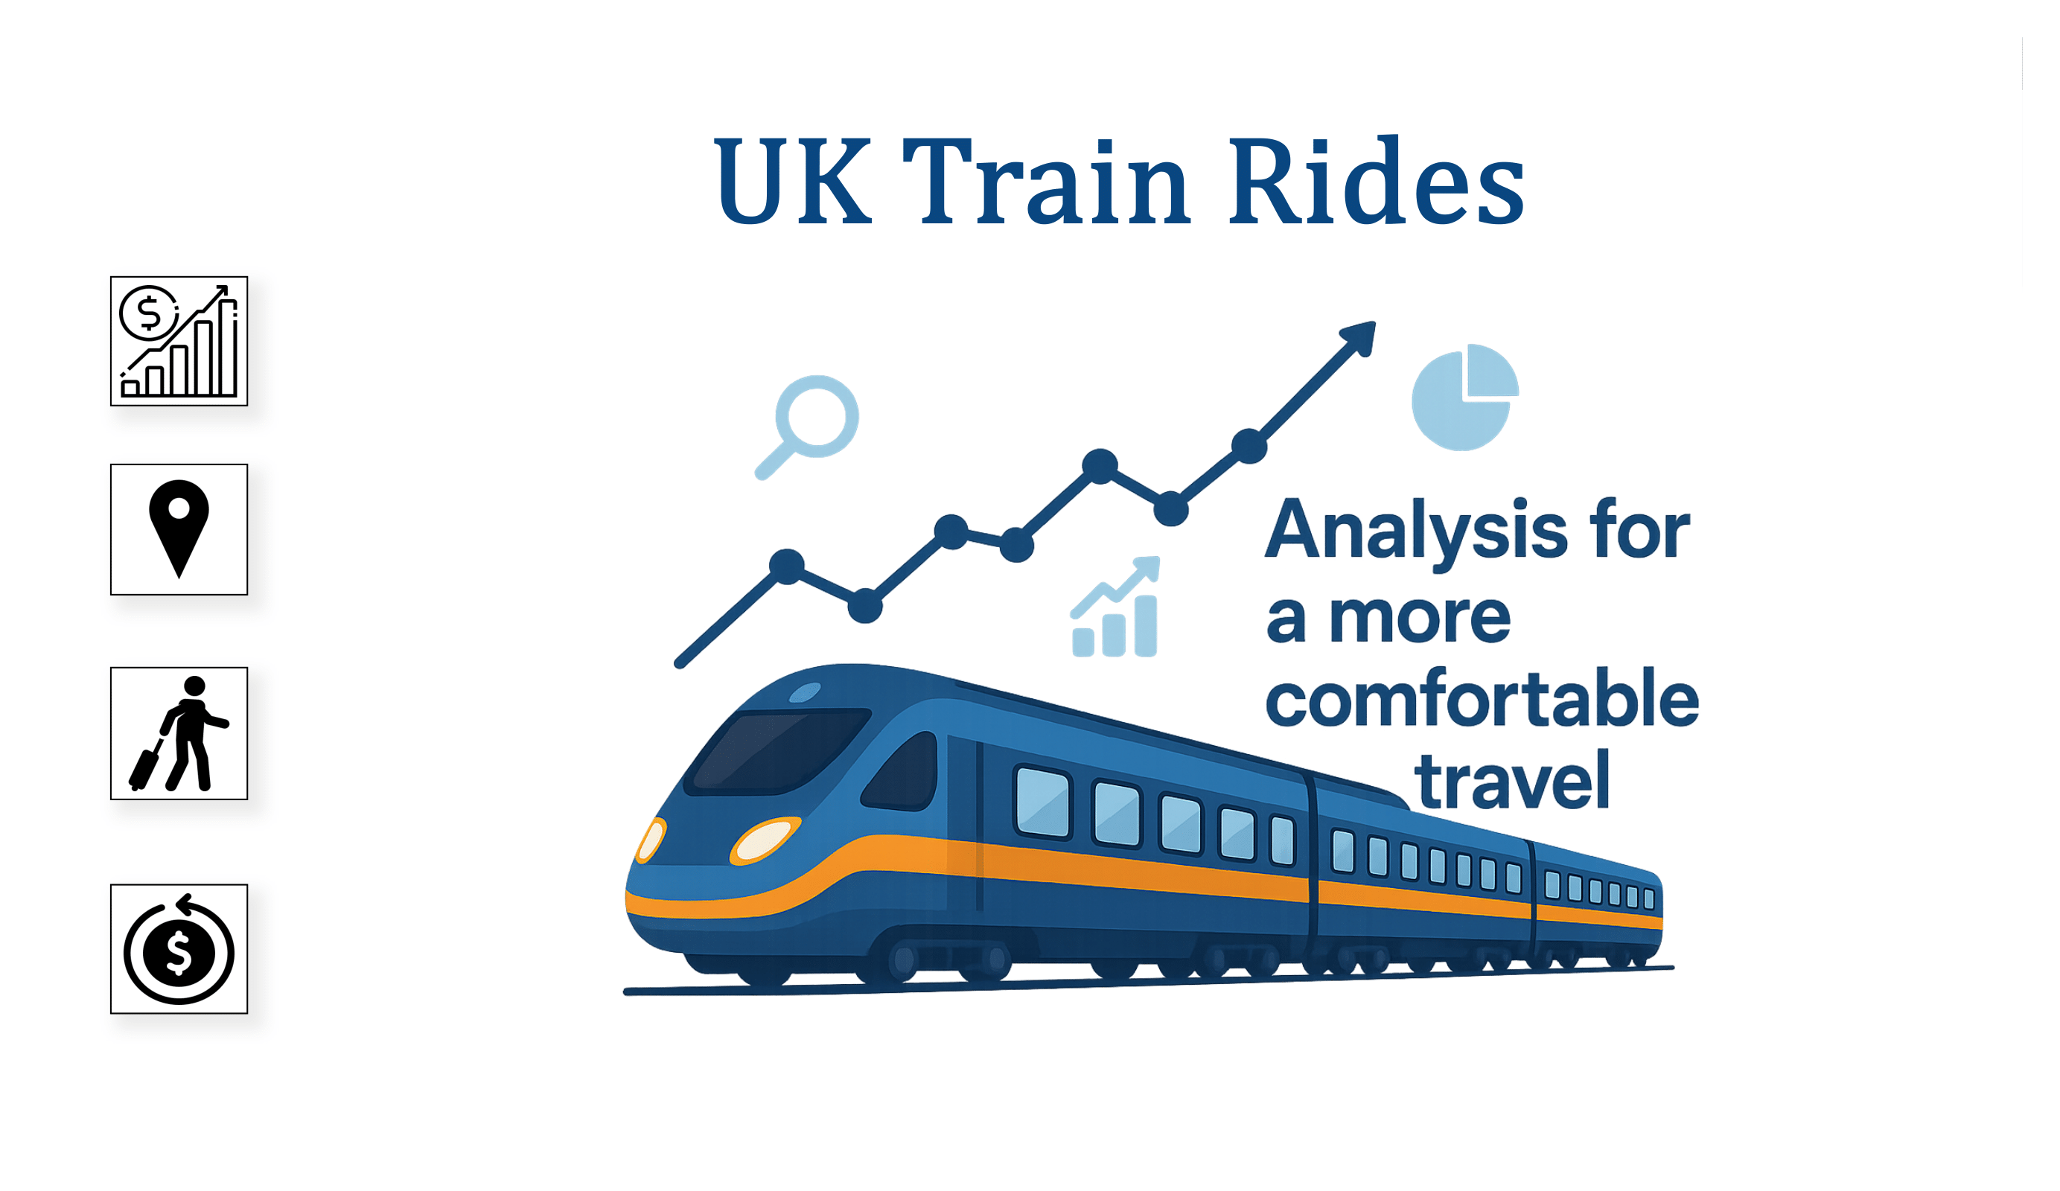
Overview Page
Content:
Bookmarks: Quick access links to other pages.
Functions: High-level navigation tool for users to quickly jump to specific pages within the report.

Slide 6
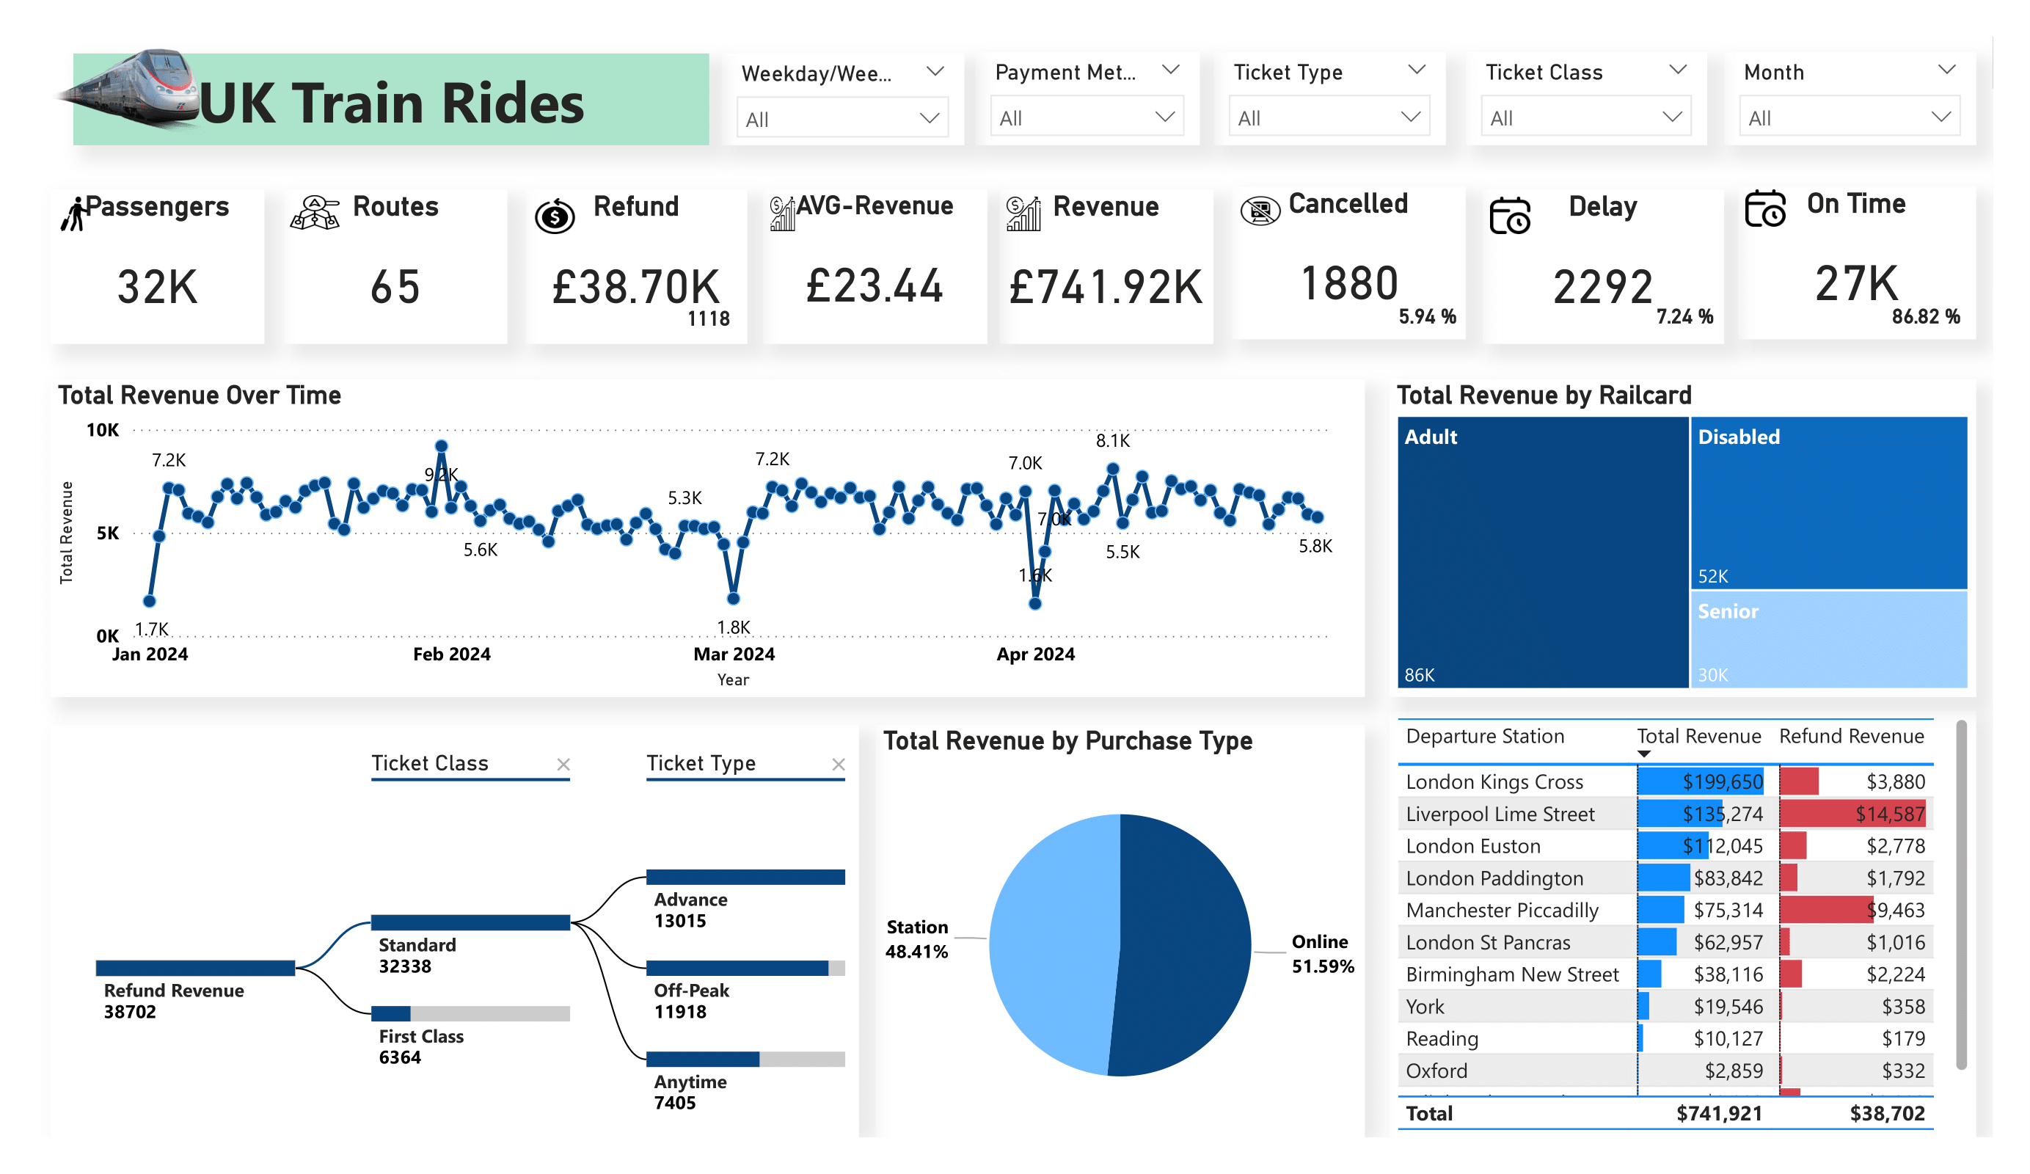
Revenue Page
Analyzes total revenue, trends, railcard performance, and the impact of refunds on overall earnings.
Metrics:
Total & Average Revenue
Revenue by Railcard & Purchase Method
Refund Impact on Revenue
Insights:
Analyzes overall revenue and trends.
Identifies railcard and purchase method performance.
Tracks refund losses and service improvements.

Slide 7
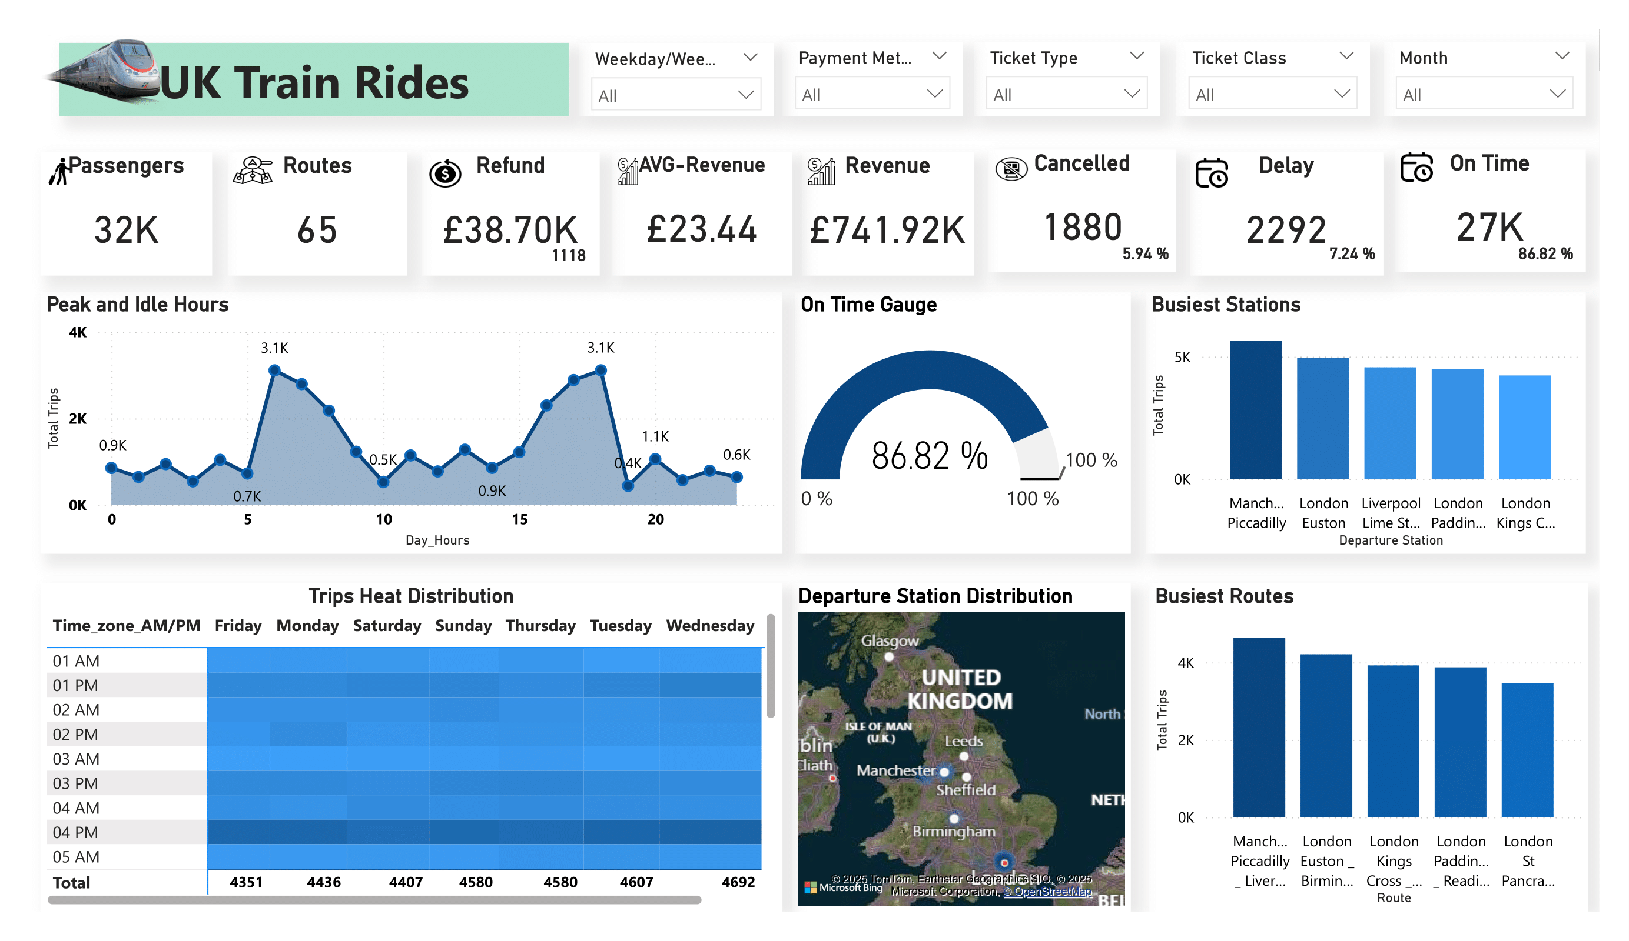
Stations & Time Page
Displays the busiest stations, peak travel times, and tracks on-time performance for better scheduling.
Metrics:
Busiest Stations & Peak Hours
On-Time Performance & Trip Distribution
Insights:
Identifies high-traffic stations for better resource allocation.
Tracks peak times for efficient scheduling.
Monitors on-time performance to improve reliability.

Slide 8
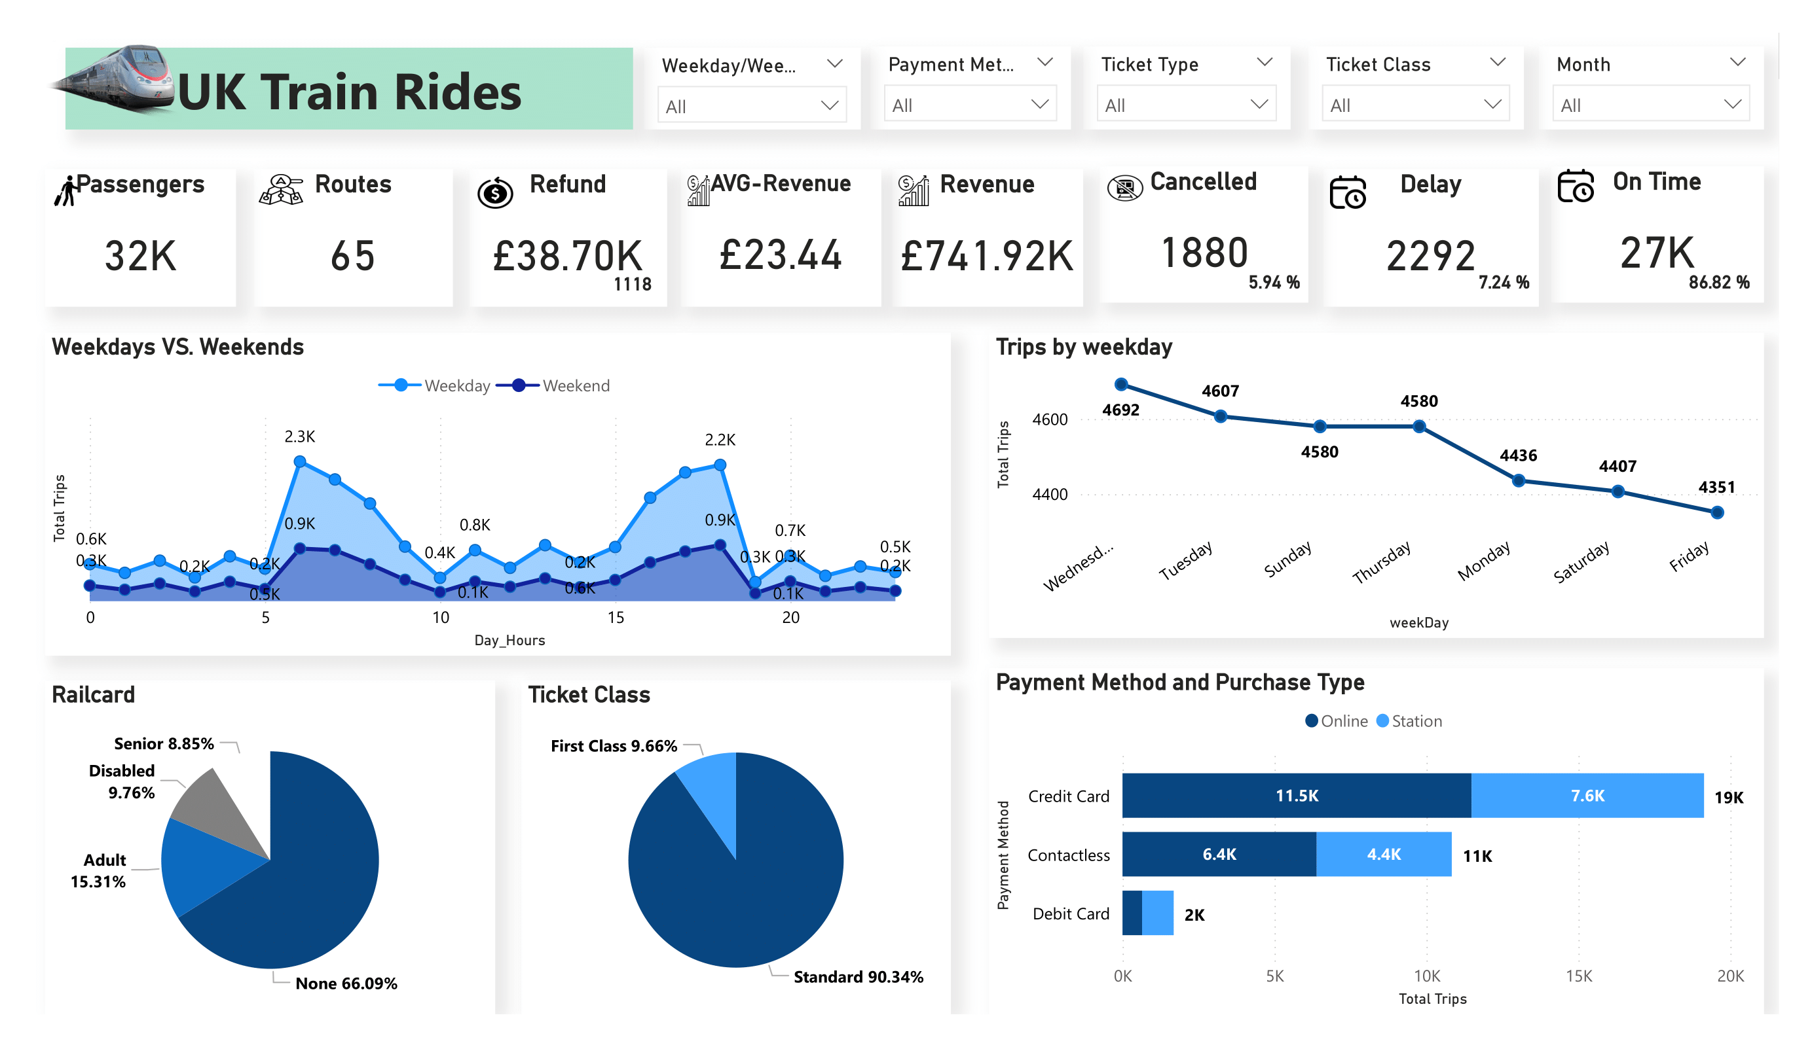
Passengers Page
Shows passenger volume trends, railcard usage, and ticket class preferences to understand ridership behavior.
Metrics:
Passenger Volume & Ticket Class Distribution
Railcard Usage & Demographics
Insights:
Analyzes trends in passenger volume.
Identifies demand for different ticket classes.
Helps target promotions based on railcard usage and demographics.

Slide 9
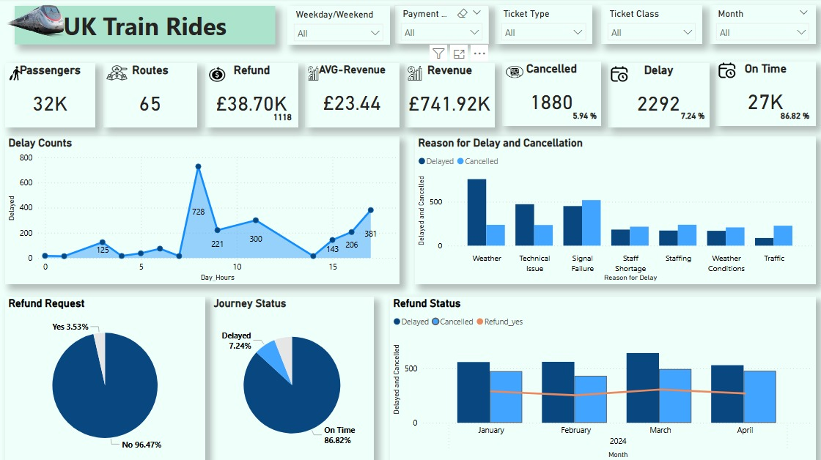
Refund & Delay Page
Tracks refund requests, delays, cancellations, and their reasons to identify performance improvement areas.
Metrics:
Delay Reasons & Refund Requests
Journey Status & Average Delay Time
Insights:
Identifies delay causes to improve operations.Tracks refunds and cancellations for customer service.Monitors delays to enhance service reliability.

Slide 10
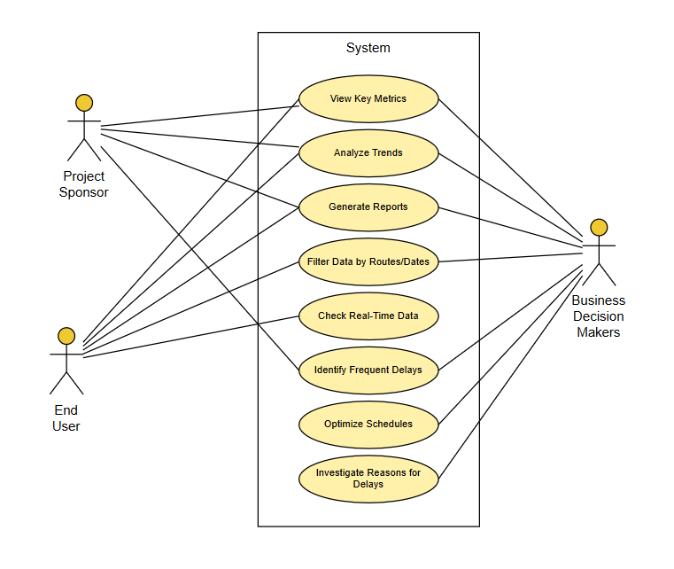
Stakeholders and Dashboard Use
Project Sponsor Needs a quick view of overall trends to support decisions. Uses the Overview to navigate to Revenue, Refund, Stations, and Passengers. Focuses on revenue trends, railcard impact, and refund breakdowns. Applies filters and exports visuals for reporting.
Business Decision Maker Looks for insights on delays, passenger demand, and service issues. Uses Refund and Delay to analyze performance problems, Stations and Time for peak demand and route usage, and Overview to access key metrics.
End User Needs simple access to clear, interactive data. Uses Passengers and Stations and Time to explore rider behavior and travel times. Uses filters to adjust views and exports data when needed.

Slide 11

Questions

Slide 12
Thank You

